Slide 1

Probability Analysis in R
Probability and its Applications

Slide 2
ABSTRACT
R is a programming language and software environment for statistical computing and graphics. The R language is widely used among statisticians and data miners for developing statistical software and data analysis. Polls, surveys of data miners, and studies of scholarly literature databases' provides a wide variety of statistical (linear and nonlinear modelling, classical statistical tests, time-series analysis, classification, clustering, …) and graphical techniques, and is highly extensible.
Election Process involves a wide study of factors, how each demographic features in Indian scenario are effecting elections and many more…So as we go on dealing with different aspects we will be in need of certain measure which will best fits to make a conclusion. It may be religious factor , Development agenda , caste etc.. To make a good conclusion from data we need a proper Statistical analysis to make a conclusion. So we make use of good Statistical tool like R to analyse data with our statistical formula and make a comment on it.

Slide 3
Miscellaneous Statistics
Charts of Male/Female Vote Percentage & Number of Electors/PC for General Elections (1951 to 2014)
Political Parties - Organisation Election, Contribution Reports, Expense Reports Analysis
Votes Polled in favour of Winner as Percentage of Electors/Voters (each State wise)
Number of Polling Stations (State wise)
Electoral Rolls Data ( Gender )
Turnout Lok Sabha Elections - 1952-2014
Lok Sabha Election Expenditure ( Party Wise )
Factors analysis in a constituency of General Elections ( Lok sabha ) in a state(like Tamil Nadu )
Exit Polls analysis
Extending data from Small sample of Poll to large Sample of Poll
Various Tests of Statistics

Slide 4

Advantages of R

Slide 5
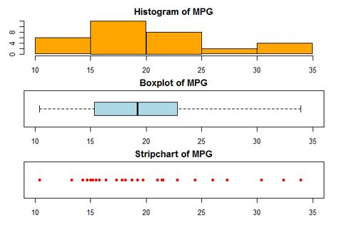
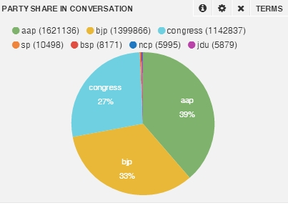
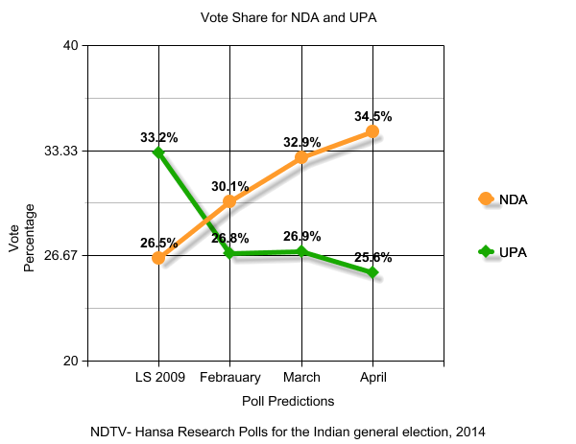
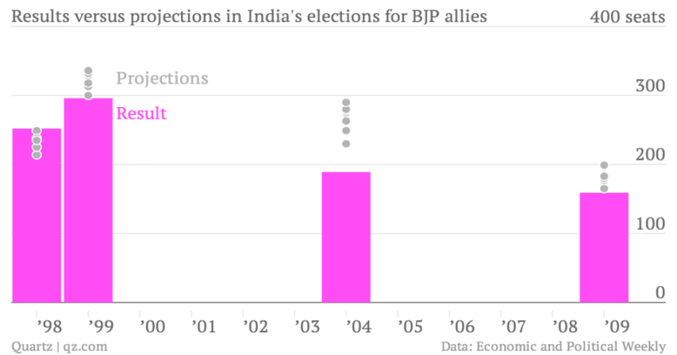
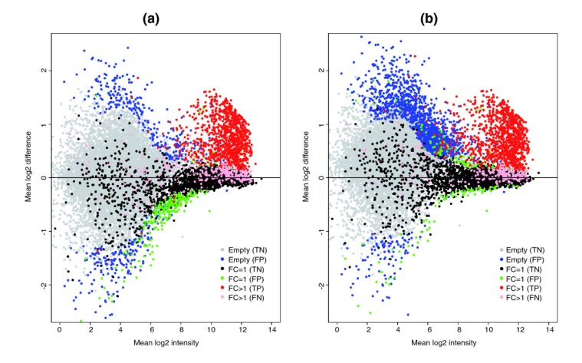
VARIOUS PLOTS IN R

Slide 6
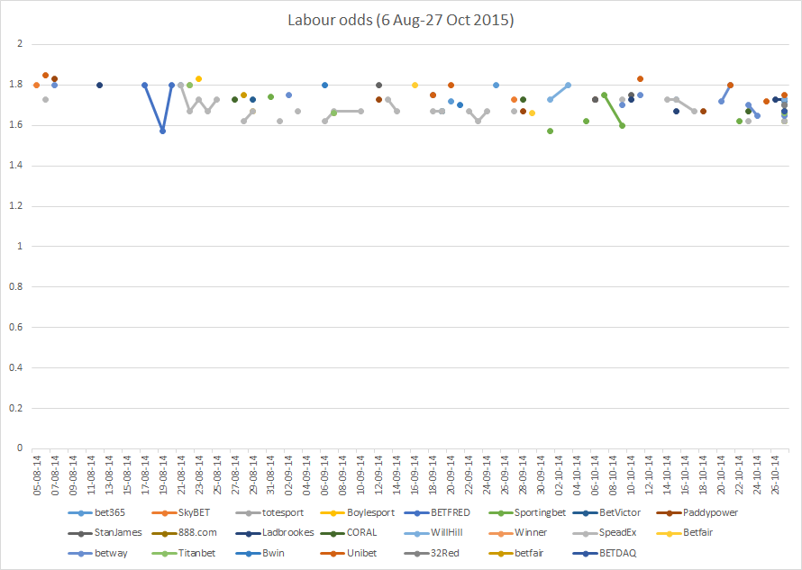
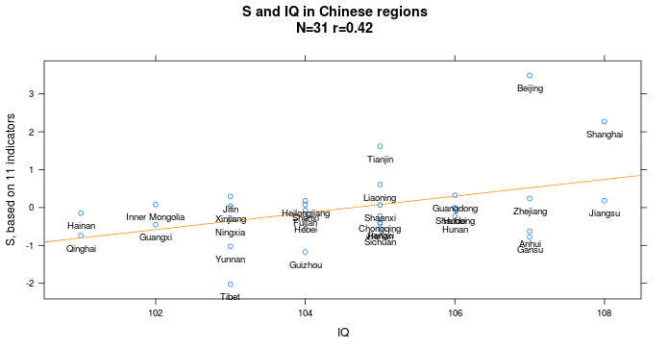
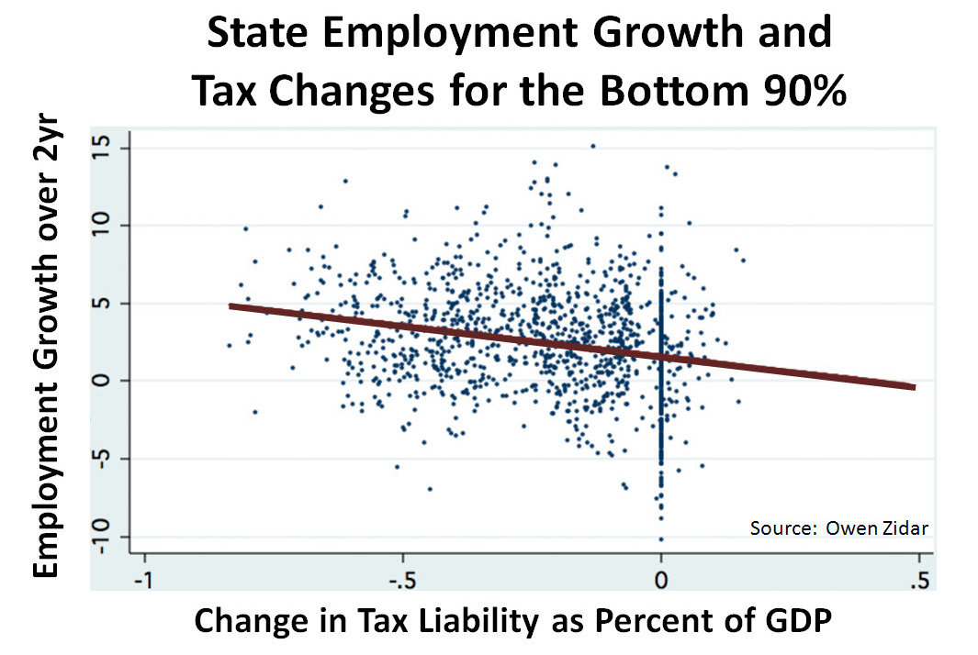
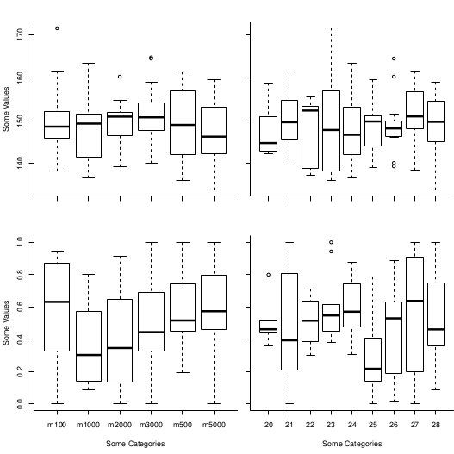
VARIOUS PLOTS IN R

Slide 7
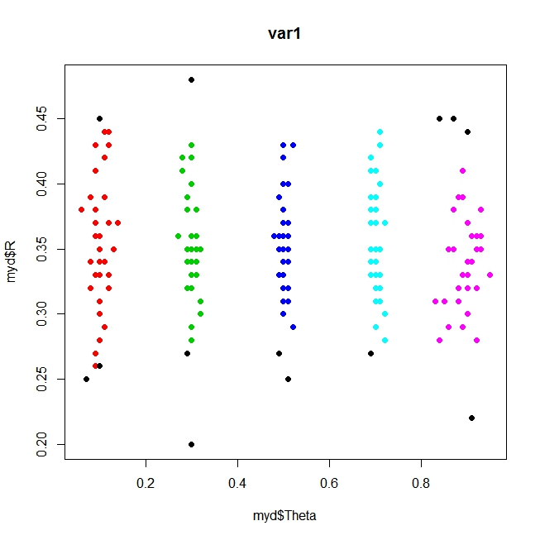
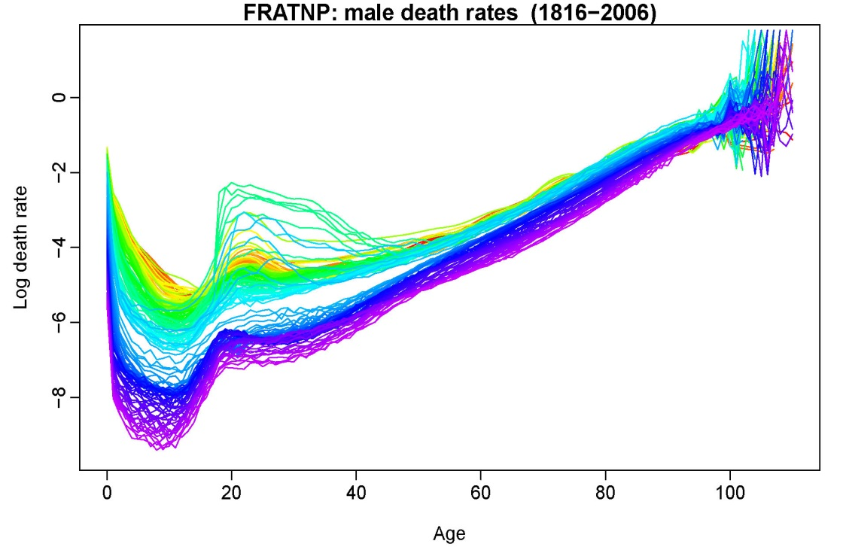
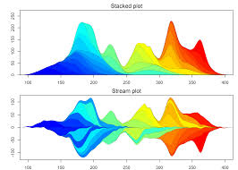
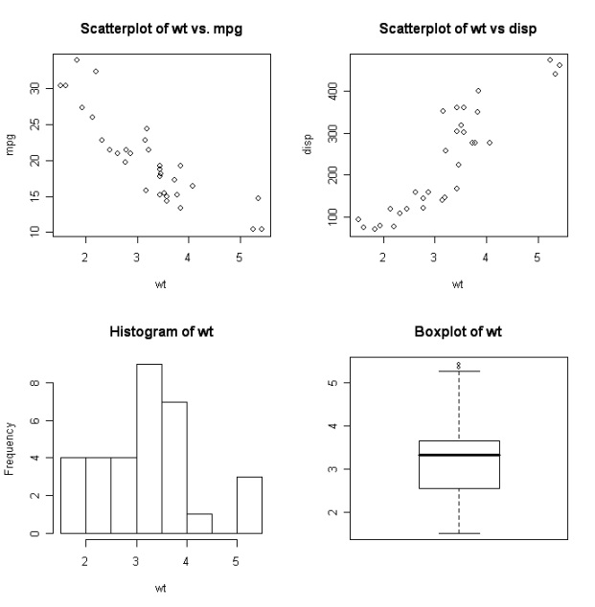
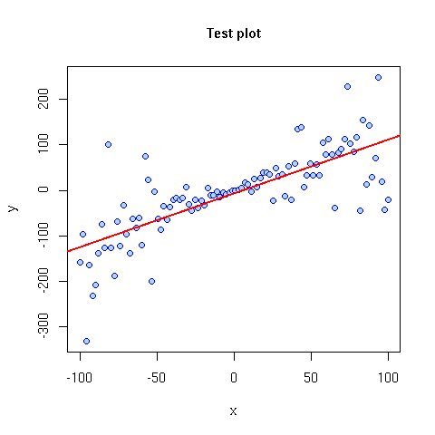
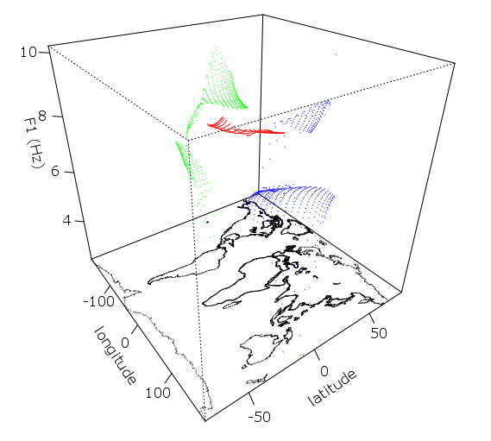
VARIOUS PLOTS IN R

Slide 8
WHAT WE CAN ANALYSE..?
If we have a certain data in ‘.ODT’ format or in excel file. We can generate moment generating function , characteristic function and joint distribution function and analyse it in R.
If we give data .We can code in R to get general summary like mean , variance , Highest and lowest values etc.. From that we can generate required function accordingly.
Further we can get general distribution curves like Gamma , Binomial ,Poisson etc.. From Data or Compare with general distributions like Normal etc..

Slide 9
FURTHUR Direct Analysis in Statistics
Testing of hypothesis
Z-test
T-test
F-test
Chi-square test

Slide 10
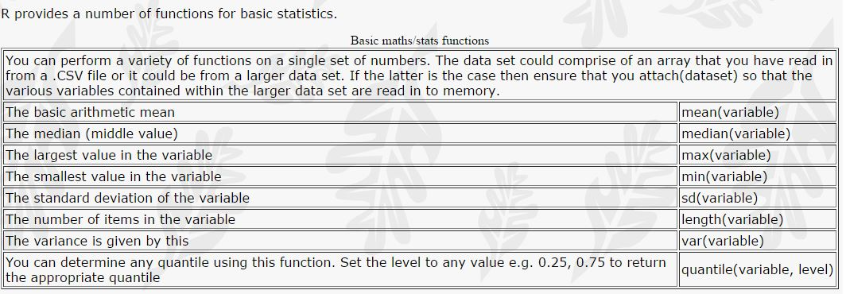
BASIC STAT FUNCTIONS in R

Slide 11
Normality Test
A more formal way of looking at the normality is by testing whether the kurtosis and skewness are significantly different from zero.
Take data and Keep it in
kurtosis.test() and skew.test() .If We see any significance difference between two functions then we can conclude that data don't follow normal distribution.
Both these tests are one-tailed, so you'll need to multiply the p-value by 2 to become two-tailed. If your p-value become larger than one you'll need to use 1-kurtosis.test() instead of kurtosis.test.

Slide 12
Z-TEST
Two sample Z-test (Difference of Means)
Comparison of the means of two independent groups of samples, taken from two populations with known variance.
Problem:
We are asked to compare the average heights of two groups. The first group (A) consists of individuals of Indian nationality (the variance of the Indian population is 5); the second group is taken from individuals of German nationality (the variance of German population variance is 8.5). The data are given below:
A: 175, 168, 168, 190, 156, 181, 182, 175, 174, 179 B: 185, 169, 173, 173, 188, 186, 175, 174, 179, 180
Since we have the variance of the population, we must proceed with a two sample Z-test. .Here to test significance of difference b/w the means of the samples from given data ( Sample is from same or different population )

Slide 13
Solution:
H0: µ1 = µ2 ( Samples has been taken from same Population)
H1: µ2 ≠ µ2 ( Samples have been taken from different Population)
The function z.test2sam provides in output the value of zeta, after receiving in input two vectors (a and b), the variance of the first population (var.a) and the variance of the second population (var.b). Using this function we obtain: a = c(175, 168, 168, 190, 156, 181, 182, 175, 174, 179) b = c(185, 169, 173, 173, 188, 186, 175, 174, 179, 180) z.test2sam(a, b, 5, 8.5) [1] -2.926254
The value of zeta is greater than the value of the critical value zeta tabulated for alpha equal to 0.05 (z-tabulated = 1.96 for a two-tailed test): then we reject the null hypothesis in favour of the alternative hypothesis. We conclude that the two means are significantly different.

Slide 14
One sample Z-test ( Single Mean )
Comparison of the sample mean with know population mean and standard deviation.
Problem: 10 volunteers have done an intelligence test; here are the results obtained. The mean obtained at the same test, from the entire population is 75. You want to check if there is a statistically significant difference (with a significance level of 95%) between the means of the sample and the population, assuming that the sample variance is known and equal to 18.
65, 78, 88, 55, 48, 95, 66, 57, 79, 81
Here We test whether given sample of size n has been drawn from a population sample with mean ‘µ’.

Slide 15
Solution:
H0: sample mean = µ
H1: sample mean >/< µ
function z.test; it receives in input a vector of values (a), the mean of the population to perform the comparison (mu), and the population variance (var); it returns the value of zeta.
a = c(65, 78, 88, 55, 48, 95, 66, 57, 79, 81) z.test(a, 75, 18) [1] -2.832353 The value of zeta is equal to -2.83, which is higher than the critical value Zcv = 1.96, withalpha = 0.05 (2-tailed test). We conclude therefore that the mean of our sample is significantly different from the mean of the population.

Slide 16

Z-test of Single Proportion
The null hypothesis of the two-tailed test about population proportion can be expressed as follows:
p = p0
where p₀ is a hypothesized value of the true population proportion p.
Let us define the test statistic z in terms of the sample proportion and the sample size:
Then the null hypothesis of the two-tailed test is to be rejected if z ≤−z_{α∕2} or z ≥ z_{α∕2} , where z_{α∕2}is the 100(1 − α) percentile of the standard normal distribution.
Problem
Suppose a coin toss turns up 12 heads out of 20 trials. At .05 significance level, can one reject the null hypothesis that the coin toss is fair?
Solution
The null hypothesis (H0)is that p = 0.5.
We use z.test() function to calculate z value
z.test(12,20,0.5)
[1] 0.8944272

Slide 17
We then compute the critical values at .05 significance level.
We use function z.testalpha(alpha) to calculate significance value of alpha
z.testalpha(0.05)
[1] -1.959964 1.959964
Answer
The test statistic 0.89443 lies between the critical values -1.9600 and 1.9600. Hence, at .05 significance level, we do not reject the null hypothesis that the coin toss is fair.

Slide 18
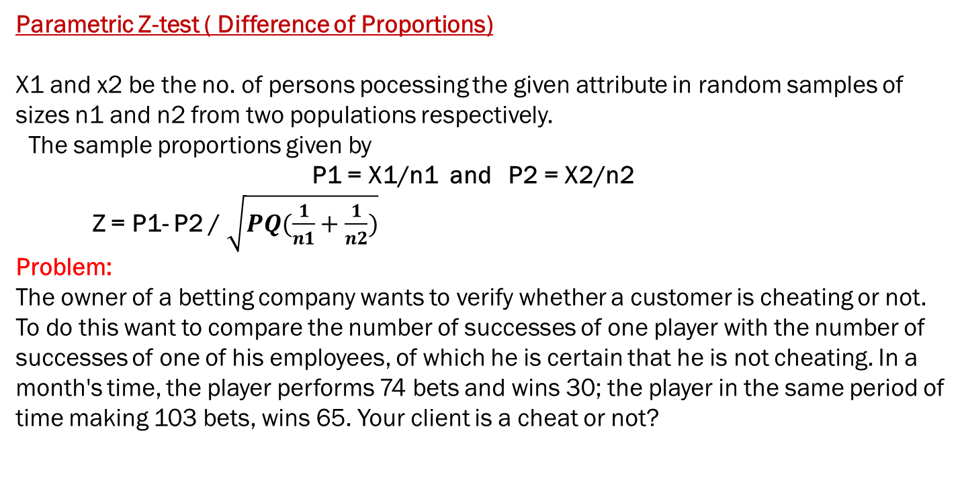
Parametric Z-test ( Difference of Proportions)
X1 and x2 be the no. of persons pocessing the given attribute in random samples of sizes n1 and n2 from two populations respectively.
The sample proportions given by
P1 = X1/n1 and P2 = X2/n2
Z = P1- P2 / $\sqrt{PQ(\frac{1}{n1}+\frac{1}{n2})}$
Problem:
The owner of a betting company wants to verify whether a customer is cheating or not. To do this want to compare the number of successes of one player with the number of successes of one of his employees, of which he is certain that he is not cheating. In a month's time, the player performs 74 bets and wins 30; the player in the same period of time making 103 bets, wins 65. Your client is a cheat or not?

Slide 19
Solution:
We will calculate z value by z.prop() function
Z.prop function calculates the value of Z, receiving input the number of successes (x1 and x2), and the total number of games (n1 and n2). We apply the function just written with the data of our problem: z.prop(30, 65, 74, 103) [1] -2.969695 We obtained a value of z greater than the value of z-tabulated (1.96), which leads us to conclude that the player that the director was looking at is actually a cheat, since its probability of success is higher than a non-cheat user.

Slide 20
F-TEST
Objective of this test is to determine whether two independent estimates of population variance differ significantly or whether two samples may be regarded as drawn from normal population having same variance.
Before proceeding with the t-test, it is necessary to evaluate the sample variances of the two groups, using a Fisher's F-test to verify the homoscedasticity (homogeneity of variances).
Problem:
A: 175, 168, 168, 190, 156, 181, 182, 175, 174, 179 B: 185, 169, 173, 173, 188, 186, 175, 174, 179, 180
Calculate F test to compare two variances.

Slide 21
Solution:
a = c(175, 168, 168, 190, 156, 181, 182, 175, 174, 179) b = c(185, 169, 173, 173, 188, 186, 175, 174, 179, 180) var.test(a,b) F test to compare two variances data: a and b F = 2.1028, num df = 9, denom df = 9, p-value = 0.2834 alternative hypothesis: true ratio of variances is not equal to 1 95 percent confidence interval: 0.5223017 8.4657950 sample estimates: ratio of variances 2.102784

Slide 22
We obtained p-value greater than 0.05, then we can assume that the two variances are homogeneous. Indeed we can compare the value of F obtained with the tabulated value of F for alpha = 0.05, degrees of freedom of numerator = 9, and degrees of freedom of denominator = 9, using the function qf(p, df.num, df.den): qf(0.95, 9, 9) [1] 3.178893 Note that the value of F computed is less than the tabulated value of F, which leads us to accept the null hypothesis of homogeneity of variances.
NOTE: The F distribution has only one tail, so with a confidence level of 95%,p = 0.95. Conversely, the t-distribution has two tails, and in the R's function(p, df) we insert a value p = 0975 when you're testing a two-tailed alternative hypothesis.

Slide 23
T-Test
One sample Student's t-test ( Single Mean)
Comparison of the sample mean with a known value, when the variance of the population is not known.
Problem: 10 volunteers have done an intelligence test; here are the results obtained. The average result of the population which received the same test, is equal to 75. You want to check if the sample mean is significantly similar (when the significance level is 95%) to the average population, assuming that the variance of the population is not known.
65, 78, 88, 55, 48, 95, 66, 57, 79, 81
Solution:
The Student's t-test for a single sample have a pre-set function in R we can apply immediately. It is the t.test (a, mu)

Slide 24
a = c(65, 78, 88, 55, 48, 95, 66, 57, 79, 81) t.test (a, mu=75) One Sample t-test data: a t = -0.783, df = 9, p-value = 0.4537 alternative hypothesis: true mean is not equal to 75 95 percent confidence interval: 60.22187 82.17813 sample estimates: mean of x 71.2

Slide 25
The function t.test on one sample provides in output the value of t calculated; also gives us degrees of freedom, the confidence interval and the average (mean of x). In order to take your statistic decision, you can proceed in two ways. We can compare the value of t with the value of the tabulated student t with 9 degrees of freedom. If we do not have tables, we can calculate the value t-tabulated in the following way: qt(0.975, 9) [1] 2.262157 The function qt (p, df) returns the value of t computed considering the significance level (we chose a significance level equal to 95%, which means that each tail is the 2.5% which corresponds to the value of p = 1 - 0.025), and the degrees of freedom. By comparing the value of t-tabulated with t-computed, t-computed appears smaller, which means that we accept the null hypothesis of equality of the averages: our sample mean is significantly similar to the mean of the population. Alternatively we could consider the p-value. With a significance level of 95%, If p-value is greater than 0.05 then we accept the null hypothesis H0; if p-value is less than 0.05 then we reject the null hypothesis H0 in favour of the alternative hypothesis H1.

Slide 26
Two sample Student’s t-test (Samples of equal variances)
t-Test to compare the means of two groups under the assumption that both samples are random, independent, and come from normally distributed population with unknown but equal variances Problem: A: 175, 168, 168, 190, 156, 181, 182, 175, 174, 179 B: 185, 169, 173, 173, 188, 186, 175, 174, 179, 180
Solution:
Here actually before going to the Problem .We need to Test for Equity of Variance. This can be done by F-TEST.
We now use t.test for homogenous variances.
t.test( a, b, var.equal=TRUE, paired=FALSE)

Slide 27
Solution:
Two Sample t-test data: a and b t = -0.9474, df = 18, p-value = 0.356 alternative hypothesis: true difference in means is not equal to 0 95 percent confidence interval: -10.93994 4.13994 sample estimates: mean of x mean of y 174.8 178.2 We obtained p-value greater than 0.05, then we can conclude that the averages of two groups are significantly similar. Indeed the value of t-computed is less than the tabulated t-value for 18 degrees of freedom, which in R we can calculate: qt(0.975, 18) [1] 2.100922 This confirms that we can accept the null hypothesis H0 of equality of the means.

Slide 28
Two sample Student's t-test(variance unknown)
Comparison of the averages of two independent groups, extracted from two populations at variance unknown; sample variances are not homogeneous.
Problem:
A: 175, 168, 168, 190, 156, 181, 182, 175, 174, 179 B: 120, 180, 125, 188, 130, 190, 110, 185, 112, 188
Solution :
Now we need to check for non homogeneouity by F-test
On observing we get p value less than 0.05 . So we can say its Non-Homogenous.
To make the comparison between the two groups, we use the function t.test with not homogeneous variances (var.equal = FALSE, which can also be omitted, because the function works on non-homogeneous variance by default) and independent samples (paired = FALSE, which can also be omitted, because by default the function works on independent samples) in this way: t.test( a, b, var.equal=FALSE, paired=FALSE)

Slide 29
Welch Two Sample t-test data: a and b t = 1.8827, df = 10.224, p-value = 0.08848 alternative hypothesis: true difference in means is not equal to 0 95 percent confidence interval: -3.95955 47.95955 sample estimates: mean of x mean of y 174.8 152.8
We obtained p-value greater than 0.05, then we can conclude that the means of the two groups are significantly similar). Indeed the value of t is less than the tabulated t-value for 10,224 degrees of freedom, which in R we can calculate: qt(0.975, 10.224) [1] 2.221539 We can accept the hypothesis H0 of equality of means.

Slide 30
Paired Student’s t-test
Comparison of the means of two sets of paired samples, taken from two populations with unknown variance.
Problem: A school athletics has taken a new instructor, and want to test the effectiveness of the new type of training proposed by comparing the average times of 10 runners in the 100 meters. Are below the time in seconds before and after training for each athlete. Before training: 12.9, 13.5, 12.8, 15.6, 17.2, 19.2, 12.6, 15.3, 14.4, 11.3 After training: 12.7, 13.6, 12.0, 15.2, 16.8, 20.0, 12.0, 15.9, 16.0, 11.1
Solution:
In this case we have two sets of paired samples, since the measurements were made on the same athletes before and after the workout. To see if there was an improvement, deterioration, or if the means of times have remained substantially the same (hypothesis H0).
t.test(a,b, paired=TRUE)

Slide 31
Paired t-test data: a and b t = -0.2133, df = 9, p-value = 0.8358 alternative hypothesis: true difference in means is not equal to 0 95 percent confidence interval: -0.5802549 0.4802549 sample estimates: mean of the differences -0.05 The p-value is greater than 0.05, then we can accept the hypothesis H0 of equality of the averages. In conclusion, the new training has not made any significant improvement (or deterioration) to the team of athletes. Similarly, we calculate the t-tabulated value: qt(0.975, 9) [1] 2.262157 t-computed < t-tabulated, so we accept the null hypothesis H0.

Slide 32
Problem:
Suppose now that the manager of the team (given the results obtained) fired the coach who has not made any improvement, and take another, more promising. We report the times of athletes after the second training: Before training: 12.9, 13.5, 12.8, 15.6, 17.2, 19.2, 12.6, 15.3, 14.4, 11.3 After the second training: 12.0, 12.2, 11.2, 13.0, 15.0, 15.8, 12.2, 13.4, 12.9, 11.0
Solution:
Now we check if there was actually an improvement, ie perform a t-test for paired data, specifying in R to test the alternative hypothesis H1 of improvement in times. To do this simply add the syntax alt = "less" when you call the t-test:
t.test(a,b, paired=TRUE, alt="less")

Slide 33
t.test(a,b, paired=TRUE, alt="less") Paired t-test data: a and b t = 5.2671, df = 9, p-value = 0.9997 alternative hypothesis: true difference in means is less than 0 95 percent confidence interval: -Inf 2.170325 sample estimates: mean of the differences 1.61
t.test(a,b, paired=TRUE, alt="greater") Paired t-test data: a and b t = 5.2671, df = 9, p-value = 0.0002579 alternative hypothesis: true difference in means is greater than 0 95 percent confidence interval: 1.049675 Inf sample estimates: mean of the differences 1.61

Slide 34
CHI-Squared TEST
CHI-SQUARED TEST For Independent of Attributes
Problem:
The owner of a betting company wants to verify whether a customer is cheating or not. To do this want to compare the number of successes of one player with the number of successes of one of his employees, of which he is certain that he is not cheating. In a month's time, the player performs 74 bets and wins 30; the player in the same period of time making 103 bets, wins 65. Your client is a cheat or not?
Solution:
We can solve it in Parametric Z-test or Non parametric chi-Squared Test
z.prop(x1,x2,n1,n2)
Or by Chi-Squared Test
Here we test whether two attributes are considered to be as independent or not

Slide 35
We solve the problem with the test of chi-square applied to a 2x2 contingency table. In R there is the function prop.test. prop. test(x = c(30, 65), n = c(74, 103), correct = FALSE)
2-sample test for equality of proportions without continuity correction data: c(30, 65) out of c(74, 103) X-squared = 8.8191, df = 1, p-value = 0.002981 alternative hypothesis: two.sided 95 percent confidence interval: -0.37125315 -0.08007196 sample estimates: prop 1 prop 2 0.4054054 0.6310680
Correct= False for large samples

Slide 36
In the case of small samples (low value of n), you must specify correct = TRUE, so as to change the computation of chi-square based on the continuity of Yates: prop.test(x = c(30, 65), n = c(74, 103), correct=TRUE) 2-sample test for equality of proportions with continuity correction data: c(30, 65) out of c(74, 103) X-squared = 7.9349, df = 1, p-value = 0.004849 alternative hypothesis: two.sided 95 percent confidence interval: -0.38286428 -0.06846083 sample estimates: prop 1 prop 2 0.4054054 0.6310680

Slide 37
In both cases, we obtained p-value less than 0.05, which leads us to reject the hypothesis of equal probability. In conclusion, the customer is a cheat. For confirmation we compare the value chi-square-value calculated with the chi-square-tabulation, which we calculate in this way: qchisq(0.950, 1) [1] 3.841459 qchisq function calculates the value of chi-square as a function of alpha and degrees of freedom. Since chi-square-calculated is greater than chi-square-tabulation, we conclude by rejecting the hypothesis H0

Slide 38

Marla Akhil reddy ( 13bce1078 ) jagmohan Singh ( 13bce1056 )

